Slide 1
Ready
Career• Life •College
School Board Workshop • April 28, 2021

Slide 2
Our Vision for Woodland Public Schools
Woodland Public Schools, in partnership with
families and the community, will create a PreK-12 system that serves and supports ALL children-and ensures that EACH child has FULL access to, is engaged in, and obtains an excellent education that prepares them for responsible citizenship and a future of adaptability and success in life and their chosen endeavors

Slide 3
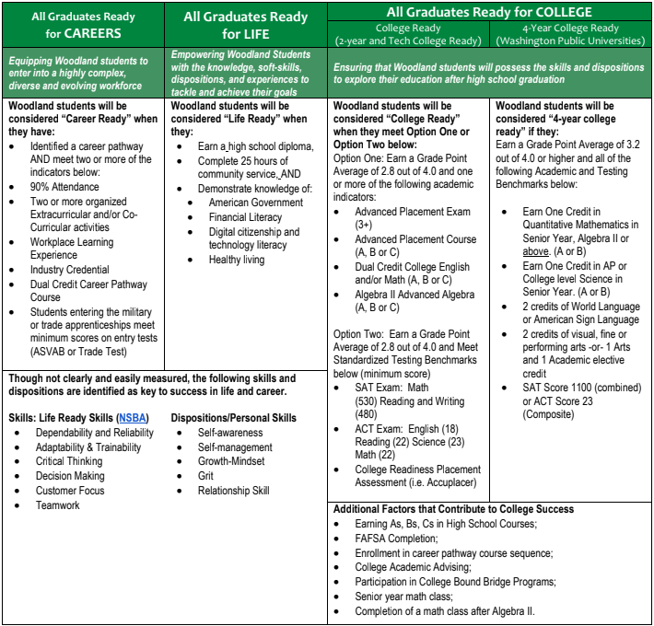

Slide 4
Career Ready
Identified a career pathway AND meet two or more of the indicators below:
90% Attendance
Two or more organized Extracurricular and/or Co-Curricular activities - (Five Lab)
Workplace Learning Experience
Industry Credential
Dual Credit Career Pathway Course
Students entering the military or trade apprenticeships meet minimum scores on entry tests (ASVAB or Trade Test)
Notes:
Highlight construction of new site to educate families on pathway options, dual credit options,etc.

Slide 5
Career Ready Opportunities
WSD Career and Technical Education Programs

Slide 6
College Ready
Option One: Earn a Grade Point Average of 2.8 out of 4.0 and one or more of the following academic indicators:
Advanced Placement Exam (3+)
Advanced Placement Course (A, B or C)
Dual Credit College English and/or Math (A, B or C)
Algebra II Advanced Algebra (A, B or C)
Option Two: Earn a Grade Point Average of 2.8 out of 4.0 and Meet Standardized Testing Benchmarks below (minimum score)
SAT Exam: Math (530) Reading and Writing (480)
ACT Exam: English (18) Reading (22) Science (23) Math (22)
College Readiness Placement Assessment (i.e. Accuplacer)

Slide 7
Increasing Access to College Credits
Increasing College in the High School
Arizona State University Digital Prep
Lower Columbia College Online Learning
Notes:
Phil can share about changes to master schedule that have been influenced by the CLC indicators

Slide 8
4-Year College Ready
Earn a Grade Point Average of 3.2 out of 4.0 or higher and all of the following Academic and Testing Benchmarks below:
Earn One Credit in Quantitative Mathematics in Senior Year, Algebra II or above. (A or B)
Earn One Credit in AP or College level Science in Senior Year. (A or B)
2 credits of World Language or American Sign Language
2 credits of visual, fine or performing arts -or- 1 Arts and 1 Academic elective credit
SAT Score 1100 (combined) or ACT Score 23 (Composite)

Slide 9
College Ready… Additional Factors
The following factors are supported in research as correlating to success in college:
Earning As, Bs, Cs;
FAFSA Completion;
Enrollment in career pathway course sequence;
College Academic Advising;
Senior year math class;
Completion of a math class after Algebra II.

Slide 10
High School and Beyond Plan
Preparing to be Career, College, and Life Ready with Naviance
Identification of career goals aided by a skills and interest assessment.
Identification of educational goals.
A four-year plan for courses taken in high school that satisfies state and local graduation requirements and aligns with students' secondary and postsecondary goals that may include education, training, and careers.
Options for satisfying state and local graduation requirements, taking into account academic acceleration (RCW 28A.320.195), dual credit courses, Career and Technical Education programs, and graduation pathway options.
Resume or activity log, that includes the student’s education, work experience, community service, including how districts recognize community service (RCW 28A.320.193)
Evidence that the student has received information on federal and state financial aid programs that help pay for postsecondary programs
Notes:
The place we update the board on Naviance progress

